Slide 1
Hospital Management System
--Database system
By Jing Li
Abhinav Singh
Suchendra Kuchipudi

Slide 2

Agenda
Project overview
Problem definition current system
Advantage of computerized system
System Design / Modules
Different types of diagram
Assumptions
Relation Model
Normalization
Tables/Database
Conclusion

Slide 3
Objective
To perform low-cost and reliable automation of database management system
The software can be customized to used in any Hospital , Clinic or Dispensary for maintaining patient details and their results
Acquire , manage and timely retrieve the information needed
The system will automate the management of the hospital making it more efficient and error free.
Standardizing data, consolidating data , ensuring data integrity and reducing inconsistencies

Slide 4
Project Description
The system includes registration of patients, storing their details into the system, and also computerized billing and payments in the pharmacy, labs and other charges in hospital
The software includes:
Maintaining, Searching, Editing Patient/Doctors/Staff Details
Providing Prescription
Report generation
Billing statement
The software can be used in any Hospital , Clinic or Dispensary for maintaining patient details and their results

Slide 5

Problems with current management
Error prone manual calculation
Lack of immediate information storage and retrieval
Time consuming
Preparation of accurate and prompt
Lack of prompt updating
Notes:
So we can see that the medical institution keep most of the work or store and manage the information in a manual method

Slide 6
Advantage of computerized Hospital Management System
Time saving
Immediate Access of data
Data can be easily insert/update/delete
Saving paper work and less error
Give facility of different types of inquiry

Slide 7
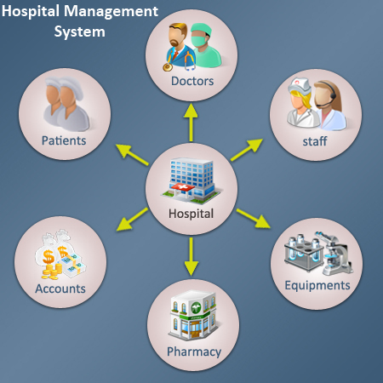
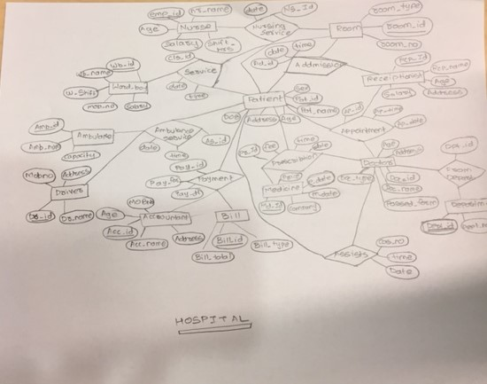
Conceptual

Slide 8
System Modules
Registration /Admission:
----- This module records basic patient related information, which is collected when the patient visits the hospital for the first time. Each patient is allocated a unique patient identification numbers also known as Hospital No.
Patient Details
----- It keeps track of all details about the patients, including patient name, address, admitted date, doctor name, room number which are entered in a form and stored for future reference.
Administration module
----- Doctor details
------ Nurse details
Medicine
Bill

Slide 9
ER-diagram

Slide 10
Assumption
Binary Relationship with 1 to 1 cardinality among the following entities:
Patient - Assists_Relation – Doctor
Patient - Admission_Relation - Room
Binary Relationship with 1 to M cardinality among the following entities:
Patient - Payment_Relation – Bills
Ternary Relationships with 1 to 1 to M cardinality among the following entities:
Patient - Prescription_Relation - Doctor
|
Medicine

Slide 11
Assumptions
Ternary Relationships with 1 to M to M cardinality among the following entities:
Room - Nursing_Service_Relation - Patient
|
Nurse
Some of the departments like Accountancy, Appointment bookings ,Lab and other hospital staff were ignored in this project.

Slide 12
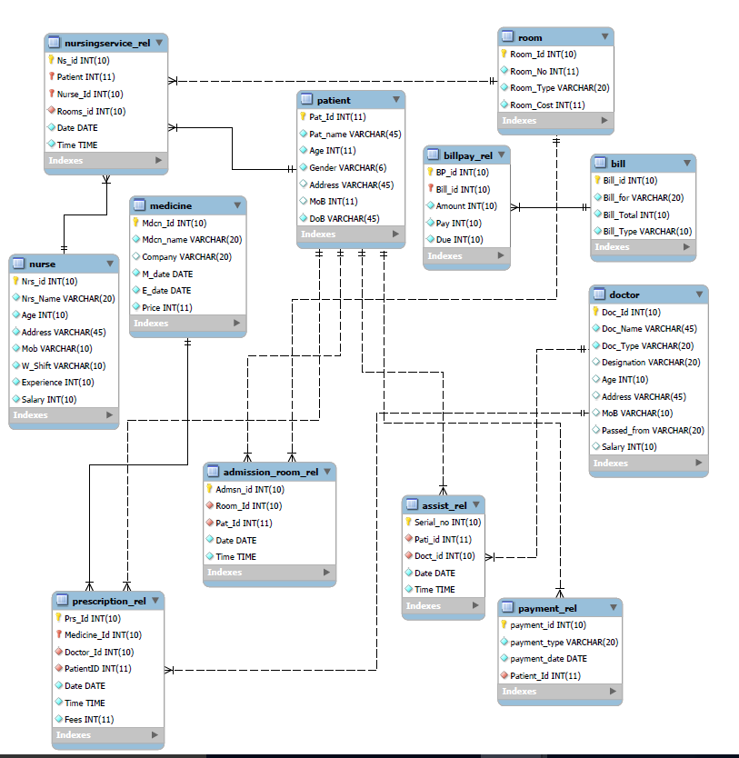
Schema diagram

Slide 13
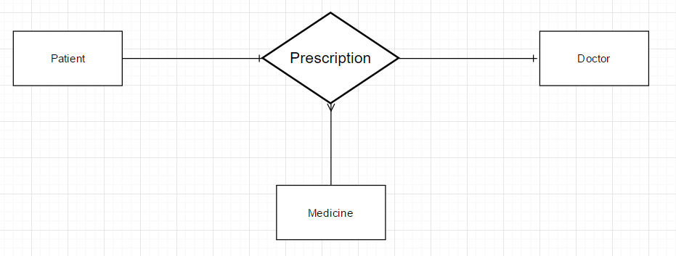
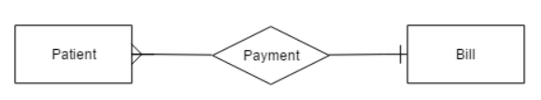
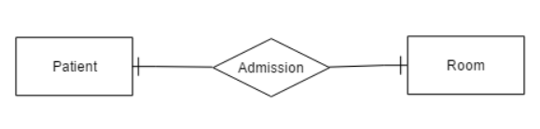
Relational Model

Slide 14
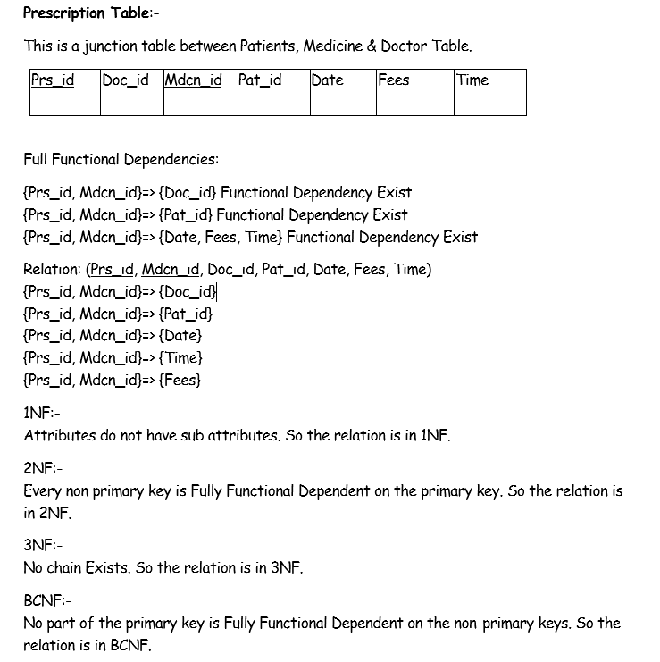
Normalization

Slide 15
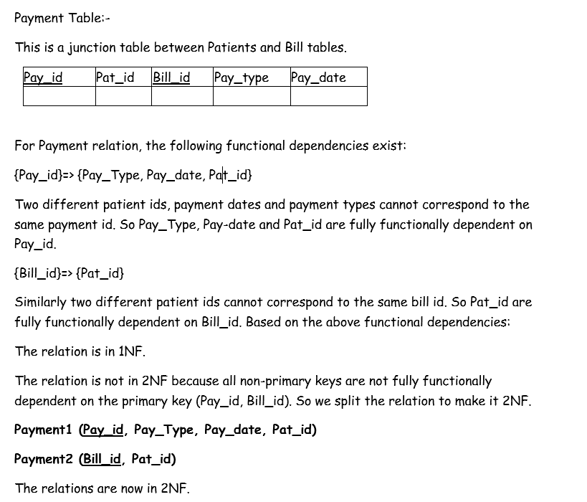
Normalization

Slide 16
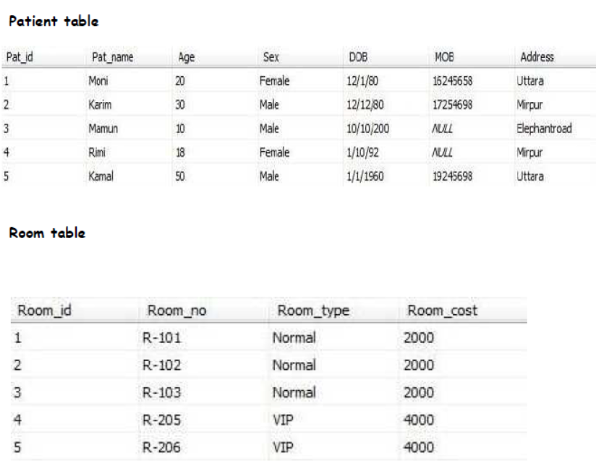
Tables

Slide 17
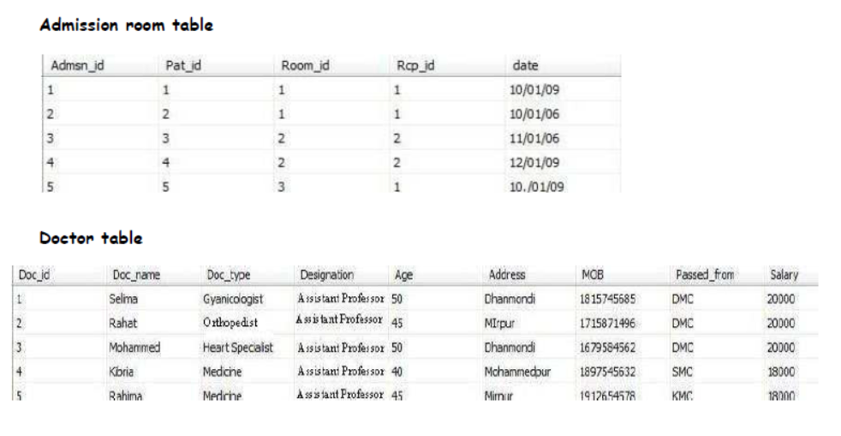
Tables

Slide 18

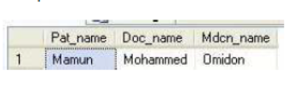
Query Samples - I

Slide 19
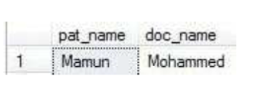
Query Samples - II

Slide 20
Conclusion
The project Hospital Management System is for computerizing the working in a hospital. The software takes care of all the requirements of an average hospital and is capable to provide easy and effective storage of information related to patients that come up to the hospital
The system can be customized update and adjusted to meet the medical organization requirement. can be used in Hospital, Clinic, Dispensary or Pathology labs for maintaining patient details and their test results.
Flexibility, Reliability, Scalability.
The system also provide the facility of backup as per the requirement

Slide 21


Q & A
Thank you!

